Slide 1




Intro to
for the language MVP
presented by Bryan Hunter Firefly Logic
Twitter #mvp13 #erlang
@bryan_hunter
@fireflylogic

Slide 2
?

Slide 3

Right tool for the job!

Slide 4
What’s Erlang?
Erlang (the language)
+
OTP
+
The ERTS
(Erlang Runtime System)
Notes:
So what exactly is Erlang? When people say Erlang they mean three things combined.

Slide 5
Erlang (the Language)
Functional
immutability, higher-order functions, referential transparency, separation of behavior and data, recursion,
Concurrency- oriented
Different model of the world
Prolog roots
Pattern matching
Notes:
First there’s the language. It’s an interesting language (I would say a beautiful one, others may disagree). Erlang is a functional programming language and grew out of Prolog. It doesn’t look much like Lisp, C, BASIC or really anything else, and this really puts some people off. The Prolog roots give it some superpowers though (like amazing pattern matching goodness), but overall it’s just a language. C# a language, Erlang a language.

Slide 6

OTP
Notes:
Then there’s OTP (the Open Telecom Platform) which you could say is analogous to the .NET framework, plus design patterns, plus guidance from characters like Uncle Bob.

Slide 7

OTP
Notes:
http://commons.wikimedia.org/wiki/File:Forge_mp3h3666.jpg
The third part the Erlang Runtime System is the tricky bit and it took me years to realize what it really is. I assumed its analogue would be the CLR or for Java developers the JVM, but that’s not quite it. In many ways the Erlang Runtime System is more like an Operating System than a language runtime.
I realize this is an odd thing to say, and later in the talk I will refer back to this as we hit specifics.
Think about writing a general purpose OS– it would have to support running video games, word processors, web servers, and a hundred programming languages. People would expect to be able to multi-task across these heterogeneous apps. It would be a hard job.
Now imagine you were going to write an operating system that was built to run a single language. Imagine your OS had a crystal clear goal of supporting reliable concurrent distributed systems and anything else was secondary. Imagine as part of the bargain your OS could place any constraint or restriction and could even shape the language in any way needed to ensure the goal of reliable, concurrent, distributed systems.
Still not easy, but history show it was doable.
Most runtimes create a thin layer over the underlying OS to expose things like file IO, threading, network sockets, etc. With Erlang the distance between your code and the underlying OS varies greatly. File IO is pretty close to the metal. With concurrency, your code is on a different planet than the underlying OS.

Slide 8
Erlang in less than 140 characters
Erlang is open, proven and cross-platform. It simplifies writing reliable, concurrent, distributed systems. Its pattern matching is FTW.

Slide 9
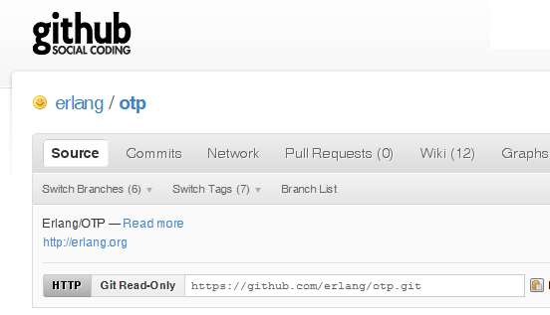

Why -> Erlang is open

Slide 10
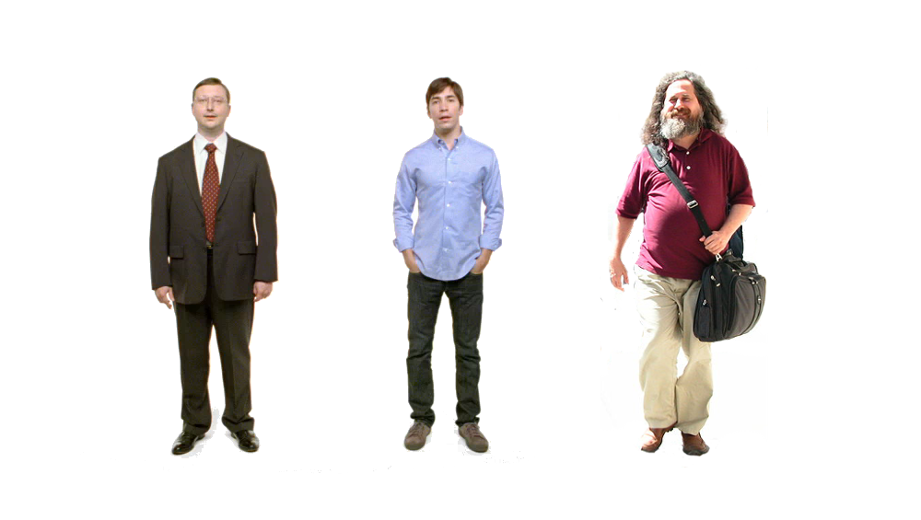
Erlang
Erlang
Erlang
Why -> Erlang is cross-platform
Notes:
I’m a PC, I’m a Mac, I’m Hagrid’s half-brother Richard Stallman

Slide 11













Why -> Erlang is proven
Notes:
Erlang was built and first proven at the Swedish Telecom giant, Ericsson. It’s a crazy thing to say “Let’s build a language”, but at Ericsson they were faced with an enormous problem of coding the digital asynchronous transfer mode switch which became the AXD301.
T-Mobile SMS
Amazon SimpleDB
Facebook chat
CouchDB
RabbitMQ
Github
Riak
And it was proven to me in Norway in the summer of 2007. Through crazy good fortune and a series of referrals I was picked to help lead an architectural risk assessment for a large oil services company in Oslo. We were reviewing a massively complex system (20 million lines of C++ and C#). Over a six week period, we were tasked with interviewing a dozen or so architects that oversaw the various subsystems. The idea was to aggregate the greatest risks perceived by each team and help provided perspective. I’ve never seen a company with better talent and resources, but with that much code they had some real problems. In some cases inheritance hierarchies 8 levels deep had gridlocked maintenance, in other areas there were event storms, all sorts of OO smells.
Of these subsystems we noticed one project wasn’t represented. We asked about it and it was a doozie that did hardcore computation. We asked who we could talk to from that team, and they said it could be arranged, but it was probably unnecessary. That subsystem had been running constantly for 4 year with zero downtime. It was viewed as a zero risk subsystem. I was stunned.

Slide 12

What are the sweet spots?
Notes:
http://commons.wikimedia.org/wiki/File:Chocolate_candy_piece.jpg

Slide 13

Why -> elsewhere concurrency is painful
Notes:
Show of hands: how many of you have written code that uses threads?
Show of hands: how many of you have a threading horror story?
Yes, threading is hard. Even in a managed language it’s hard. When you’re a kid programmer threading is “totally badass”. A few missing toes and getting calls to troubleshoot production systems on holidays you change your mind.
There is an inverse relationship between a developers seniority and their eagerness to take on threading. Or another way: there’s a name for people who are excited to write threaded code– junior developer

Slide 14
Two thing to remember about
Concurrency
1) Shared memory concurrency is hard
2) Message passing concurrency is easy

Slide 15
“The performance
of a concurrent language
is predicated by three things:
the context switching time,
The message passing time,
and the time to create a process.”
–Mike Williams

Slide 16
Erlang Processes
are the unit of concurrency.
You structure your programs around these units of concurrency.
Notes:
So what does Erlang do to for concurrency?
In Erlang there is no concept of a thread. You write your code as simple sequential code. When you want to have something run concurrently you spawn a process and send messages to that process.

Slide 17
One .NET 4.0 Thread (allocates one megabyte)
**********
**********
**********
**********
**********
**********
**********
**********
**********
**********
**********
**********
**********
**********
**********
**********
**********
**********
**********
**********
**********
**********
**********
**********
**********
**********
**********
**********
**********
**********
**********
**********
**********
**********
**********
**********
**********
**********
**********
**********
**********
**********
**********
**********
**********
**********
**********
**********
**********
**********
Heap
Mailbox
Stack
**********
**********
**********
**********
**********
**********
**********
**********
**********
**********
**********
**********
**********
**********
**********
**********
**********
**********
**********
**********
**********
**********
**********
**********
**********
**********
**********
**********
**********
**********
**********
**********
**********
**********
**********
**********
**********
**********
**********
**********
**********
**********
**********
**********
**********
**********
**********
**********
**********
**********
Garbage Collector
Links and Monitors
One Erlang Process (allocates one kilobyte)
*
Why -> elsewhere concurrency is painful
Notes:
An Erlang process is not the same thing as a Windows or Linux process. No relation and no relation to a thread either. In fact an Erlang process is much lighter than either. An Erlang process weighs 933 bytes and a .NET thread in the 4.0 framework weighs 1 megabyte. 1,000 versus 1,000,000. These are different beasts entirely. The amount of RAM allocated isn’t even the biggest part. When you have two threads and you switch context there are 10s of thousands of CPU operations that have to happen. The OS only knows so much about what your doing and has to do a lot of housekeeping.

Slide 18
*
*
*
Reductions
- Do 2,000 operations
reduction1 reduction3 .
Reduction2000
- Move to the next guy - Repeat
CPU Core
Why -> elsewhere concurrency is painful
Notes:
As a deep dive, internally Erlang uses a concept called reductions. So imagine you have 100 processes and 4 cores.
Each process has it’s own heap and its own garbage collector. There is no shared memory between processes. Processes use copy-only message passing.
Fire up a thousand threads in .NET and see what happens. In Erlang threads are very cheap. You can fire up a million and have them do stuff and shutdown in a second.

Slide 19
***** *****
***** *****
***** *****
***** *****
Core
Core
Core
Core
Why -> elsewhere concurrency is painful

Slide 20

Distribution: built-in from the start
Notes:
http://commons.wikimedia.org/wiki/File:Long_Water_birds.JPG

Slide 21

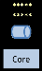
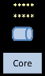
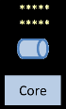
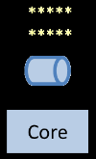
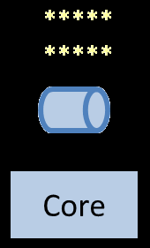
Distribution: built-in from the start

Slide 22
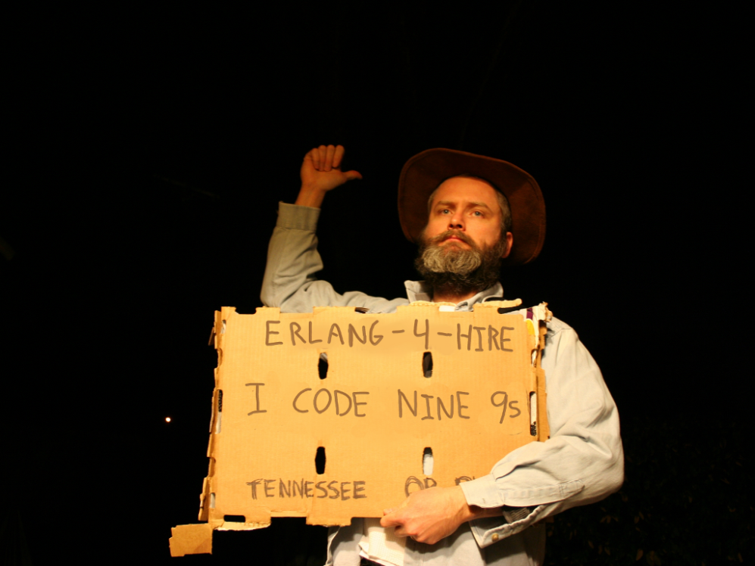
Nines | Uptime | Annual Downtime
9 | 99.9999999% | 30 milliseconds
8 | 99.9999990% | 300 milliseconds
7 | 99.9999900% | 3 seconds
6 | 99.9999000% | 32 seconds
5 | 99.9990000% | 5 minutes
4 | 99.9900000% | 53 minutes
3 | 99.9000000% | 8 hours, 46 minutes
2 | 99.0000000% | 3 days, 15 hours, 36 minutes
Safe
Supervisor
Worker
Worker
Links and monitors
No masters
Hot code loading
simple distribution, safe concurrency
Why -> reliability

Slide 23
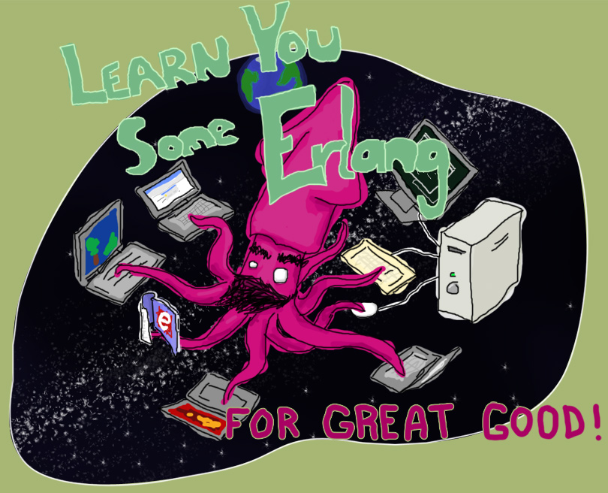
“Learn You Some Erlang for Great Good!” http://learnyousomeerlang.com/
How -> read this excellent and free online book

Slide 24

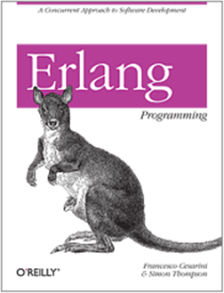

How -> read some books

Slide 25

Search “pragmatic kevin smith”
How -> code alongside Kevin Smith for eight screencasts

Slide 26
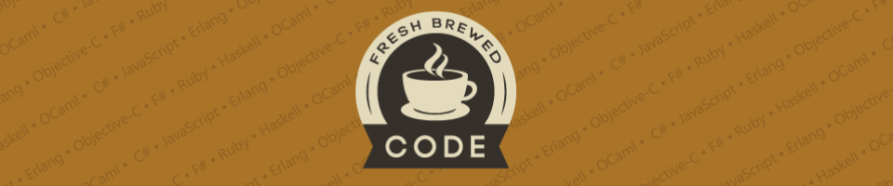
My blog:
http://freshbrewedcode.com/bryanhunter/
How -> visit my blog

Slide 27

http://nashfp.org
How -> join your local FP group

Slide 28
Bryan Hunter
Twitter: @bryan_hunter
Email: bryan.hunter@fireflylogic.com
Firefly Logic, Inc.
1000 Main Street, Suite 201 Nashville, TN 37206
http://fireflylogic.com
How -> keep in touch

